Slide 1


Object Oriented Programming –
Sagar Kalthiya

Slide 2

Agenda for Today : -
OOPs Concept
Packages
Encapsulation
Abstract Classes
Interfaces
Inheritance
Polymorphism
Inner Classes
Static and Final Keywords

Slide 3
OOPS Concept

Slide 4
Object-Oriented Programming System or structure is a methodology or paradigm to design a program using classes and objects.

Slide 5
Object And Classes

Slide 6
Objects: An entity that has state and behavior is known as an object e.g., chair, bike, marker, pen, table, car, television.
Class: A class is a template or blueprint from which objects are created. A class contain data members(state) and methods(behavior).
Example: Television has properties like channel and volume. Behavior include changeChannel, channelVolume.

Slide 7
Packages

Slide 8
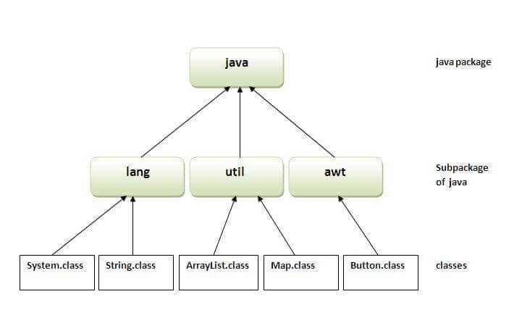
A java package is a group of similar types of classes, interfaces and sub-packages.

Slide 9
Access Modifiers

Slide 10
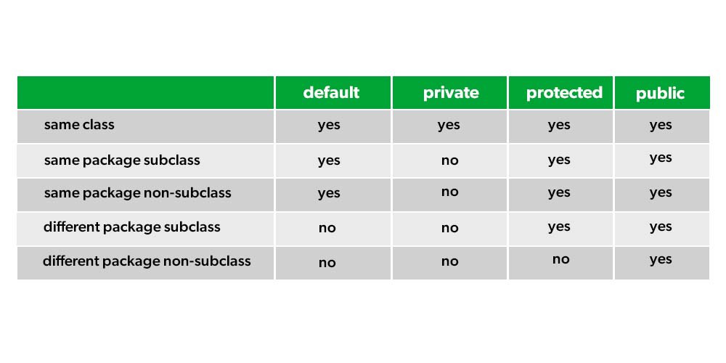
The access modifiers it specifies the accessibility or scope of a field, method, constructor, or class.

Slide 11
Encapsulation

Slide 12
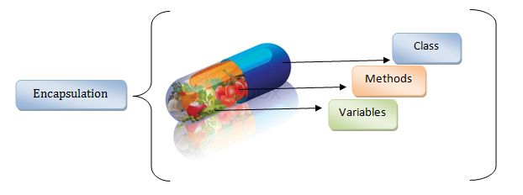
Encapsulation in Java is a process of wrapping code and data together into a single unit, for example, a capsule which is mixed of several medicines

Slide 13
Abstraction

Slide 14
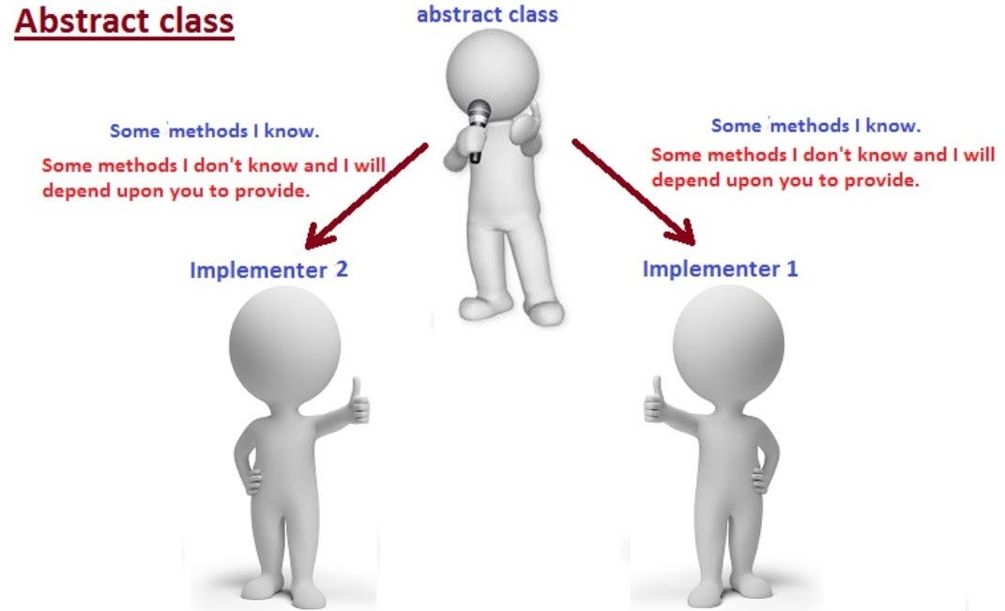
Data abstraction is the process of hiding certain details and showing only essential information to the user. Abstraction can be achieved with either abstract classes or interfaces

Slide 15
Interface

Slide 16
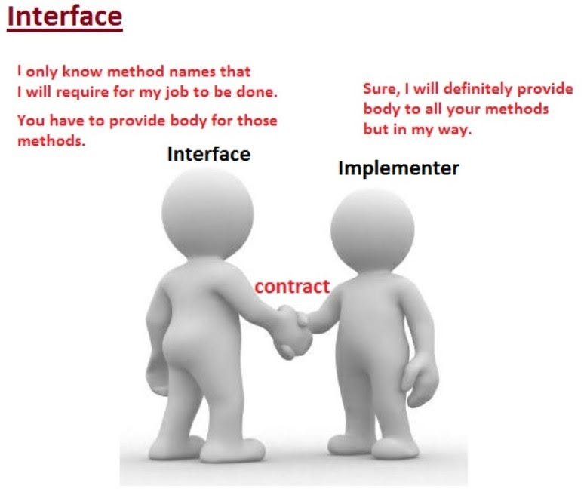
An interface in Java is a blueprint of a class. It has static constants and abstract methods.

Slide 17
Example :-
abstract class test1
{
abstract public void meth1();
abstract public void meth2();
}
interface test1
{
void meth1();
void meth2();
}
class test2 implements test1
{
public void meth1()
{
System.out.println(“meth1”);
}
public void meth2()
{
System.out.println(“meth2”);
}
}

Slide 18
Inheritance

Slide 19
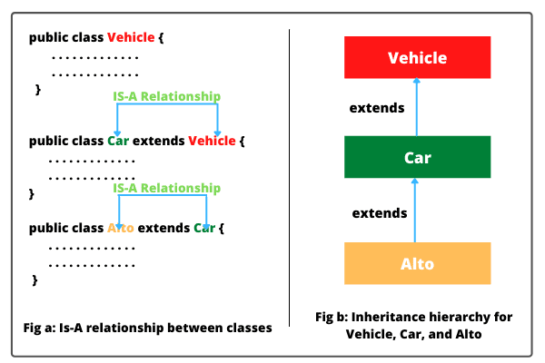
Inheritance in Java is a mechanism in which one object acquires all the properties and behaviors of a parent object

Slide 20
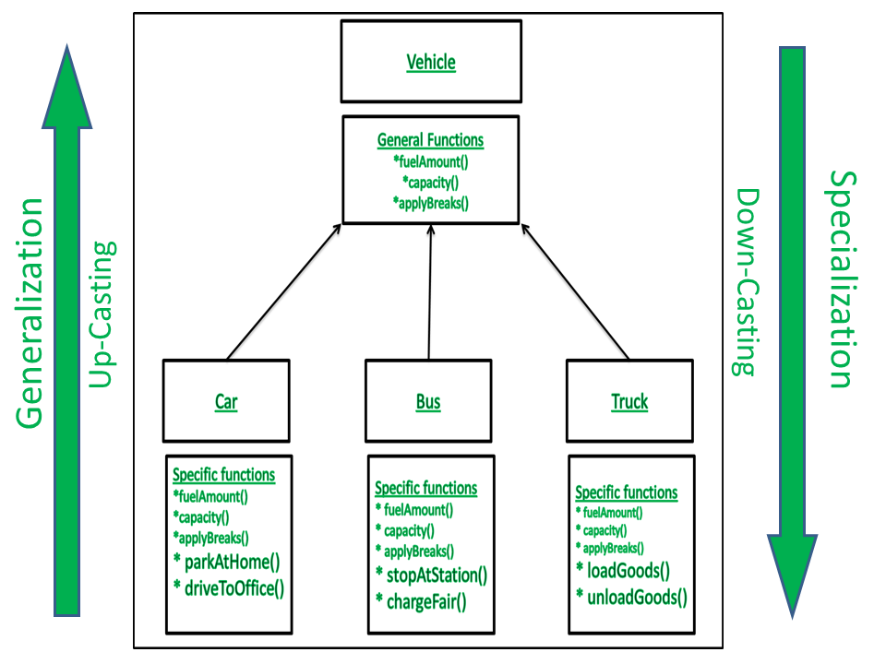
Generalization
Specialization

Slide 21
Polymorphism

Slide 22
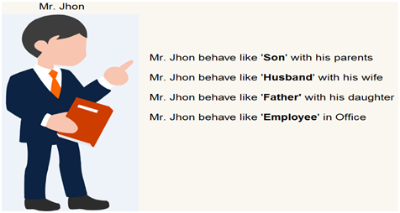
The word polymorphism means having many forms. In simple words, we can define polymorphism as the ability of a message to be displayed in more than one form.

Slide 23
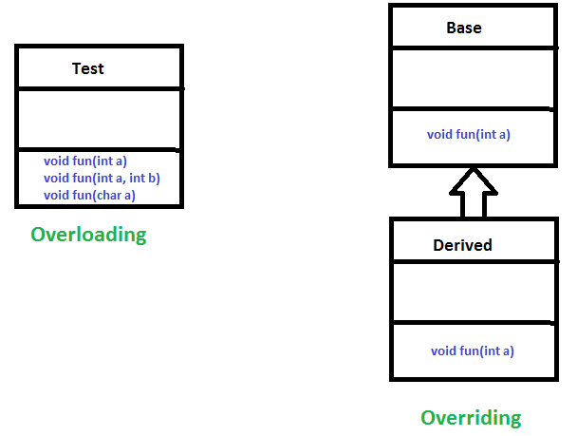
In Java polymorphism is mainly divided into two types:
Compile-time Polymorphism
Runtime Polymorphism

Slide 24
Java Inner Classes

Slide 25
Java inner class or nested class is a class that is declared inside the class or interface.
We use inner classes to logically group classes and interfaces in one place to be more readable and maintainable.
It can access all the members of the outer class, including private data members and methods.
Optimizing the code of outer class and reduce the code complexity of outer class.

Slide 26
Types of Inner Classes in Java
Nested Inner Class
Method Local Inner Class
Anonymous Inner Class
Static Inner Class

Slide 27
Task for Class :-
Write a class Student having following properties and methods:
Property: rollNumber, name, course, marks1, marks2, marks3
Methods: calculateTotal(), calculateAverage(), calculateGrade()
Create getter and setter methods.
Create class StudentTest with main method for calling Student class.
StudentTest should contain atleast 5 student objects with different grades.
Implement toString method to display details of each student.
Also display grades of each student.
Store the student file in a package student;

Slide 28
Task For Interface :-
Create a class phone which is having to method call() and sms(), create an interface camera which having abstract method click() and record(), create another interface MusicPlayer having abstract class play() and stop() method.
Create concrete class SmartPhone which extends class phone and implements interface camera and MusicPlayer and display all the mentioned method by creating object and references

Slide 29
Task For Inheritance
Create a class Account with properties like accountNo, name, address, phoneNo, dob, balance.
Write getter and setter methods for all properties
Create Parameterized Constructor for class Account.
Create a method closeAccount()
Create a class SavingsAccount which inherits Account class.
Create different methods in SavingsAccount class like withdraw(), deposit(), fixedDeposit().
Create a class LoanAccount which also inherits Account class.
Create different methods in LoanAccount class like payEMI(), topUpLoan(), repayment()

Slide 30
Task For Abstract Class
Create an abstract class Shape having no properties and two abstract method perimeter() and area().
Create two concrete class Circle and Rectangle which extends abstract class Shape and override the abstract method Perimeter() and area().
Display perimeter and area of circle and rectangle.

Slide 31
Q & A

